Slide 1
Social Interactivity Mentor for Youth with Autism using the NAO Robot (SIMYAN)
Final Presentation
Andrew Nguyen, Bryce George, Colton Homuth, William Ross
Sponsor: Dr. Adham Atyabi
Faculty Sponsor: Mr. Bill Michael
May 7, 2021
Notes:
Bryce

Slide 2
Project Recap
Objective:
Create a framework for the NAO robot to support future implementation of ASD treatment/intervention activities designed by medical professionals and researchers.
Core SDK
Supports implementation of advanced social interactivity behaviors
Framework for building interactive activities
Orchestrates provided services
Extensible, documented, and easy-to-use
Drawing Demo
A PoC activity
Guides human subject through a drawing exercise
Demonstrates a social interaction between the robot and the subject
Notes:
Bryce

Slide 3
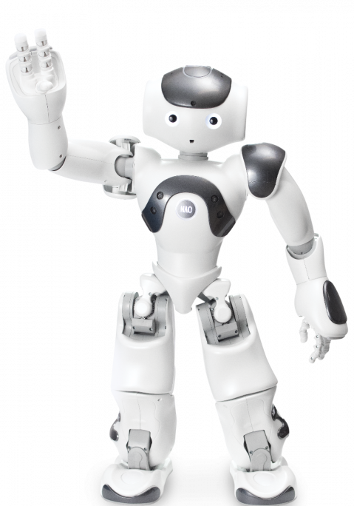
Presentation Overview
Problem Review
Project Requirements
Solution Overview
Test Strategy & Results
Project Status
Goals
Schedule
Budget
Lessons Learned
Conclusion
https://www.eduporium.com/media/catalog/product/cache/c687aa7517cf01e65c009f6943c2b1e9/n/a/nao-print_06_4.png
Notes:
Bryce

Slide 4
Problem Review
ASD can impair social development which is vital for success is today’s society
Robotics can be used to help develop these skills in children with ASD
NAO robot is designed for social interactivity
Robot comes with good functionality but still requires further development
Notes:
Will

Slide 5
Requirements
Integrate Jetson Nano GPU wirelessly
Integrate Kinect to Jetson Nano
Create, Document and Test SIMYAN Framework
Drawing Activity Proof of Concept
Machine Learning for additional autonomy
Notes:
Will

Slide 6
REQUIREMENTS SPECIFICATIONS
# | Use Case | Functional Requirements | Quality of Service Requirements
1 | Load Master Module | Allocate all necessary resources and load the Activities Master Module Detect subject within 5m of starting position | Performed on robot startup Verbal notification of completion
2 | Initialize Activities Master Module | Verbally greet subject Orient face to look at subject (+/- 5°) Allocate/initialize all master level subroutines | Greet subject < 1s after detection
Notes:
Will

Slide 7
REQUIREMENTS SPECIFICATIONS
# | Use Case | Functional Requirements | Quality of Service Requirements
3 | Start Activity | Verbally explain operation instructions Verify valid verbal activity selections Notify of invalid activity selections and re-prompt Discover all available activity modules Load and initialize selected activity module | Verify and acknowledge selections <= 1s after heard
Notes:
Will

Slide 8
REQUIREMENTS SPECIFICATIONS
# | Use Case | Functional Requirements | Quality of Service Requirements
4 | Select Object to Draw | Verbally explain drawing activity Verbally list drawable objects Prompt for object selection Verify object selection Notify of invalid object selections and re-prompt | Verify and acknowledge selections <= 1s after heard
Notes:
Will

Slide 9
REQUIREMENTS SPECIFICATIONS
# | Use Case | Functional Requirements | Quality of Service Requirements
5 | Draw Object | Locate/detect drawing surface within 5m of position Notify of no drawing surface found and prompt for next action Detect drawing surface boundaries Notify inaccessible drawing surface conditions and instruct how to position correctly | Detect drawing surface in <= 3s Identify drawing surface boundaries in <= 1s
Notes:
Will

Slide 10
REQUIREMENTS SPECIFICATIONS
# | Use Case | Functional Requirements | Quality of Service Requirements
5 | Draw Object (continued) | Load necessary hand/arm motor control module(s) Locate object drawing instructions Execute drawing instructions to draw the object on the drawing surface Able to draw square Four angles within +/- 1° of 90° Four sides same length to within +/- 5mm
Notes:
Will

Slide 11
REQUIREMENTS SPECIFICATIONS
# | Use Case | Functional Requirements | Quality of Service Requirements
5 | Draw Object (continued) | Able to draw rectangle Four angles within +/- 1° of 90° Two sets of sides same length to within +/- 5mm Able to draw circle No segment of circumference varies by more than +/- 5% of radius length in distance from the center
Notes:
Will

Slide 12
REQUIREMENTS SPECIFICATIONS
# | Use Case | Functional Requirements | Quality of Service Requirements
5 | Draw Object (continued) | Able to draw triangle One angle +/-1° of 90° Two angles +/-1° of 45° Length of sides adjacent to 90° angle are same length within +/- 5mm
Notes:
Will

Slide 13
REQUIREMENTS SPECIFICATIONS
# | Use Case | Functional Requirements | Quality of Service Requirements
6 | Interact with Subject | Select an appropriate user interaction statement Speak interaction statement to subject Listen for verbal response to an interrogative statement Evaluate response statement | Select or generate an interaction statement in <= 3s Evaluate a response statement in <= 3s
Notes:
Andrew

Slide 14
REQUIREMENTS SPECIFICATIONS
# | Use Case | Functional Requirements | Quality of Service Requirements
7 | Complete Activity | Evaluate whether activity can be repeated Ask whether to repeat activity or exit activity Verify and verbally acknowledge choice to repeat or exit the activity Re-initialize activity module Exit and unload activity module | Verify and acknowledge selections <= 1s after heard
Notes:
Bryce

Slide 15
Standards
Coding Standards | Python PEP 8 formatting style Use 4 spaces instead of tabs Comments Describe all functions and their parameters References/links to supporting documentation (Optional) Custom utilities should provide a command line or GUI interface
Documentation Standards (GitHub) | Committed to UCCS-Social-Robotics/docs Must include a Wiki page or markdown for each module Include author(s) GitHub username and date information at the top of documentation files and wiki pages
Safety Standards | Subscribe to IEC 60601 technical standards Covid-19 Safety Protocol
Notes:
Andrew

Slide 16
Solution Overview
Team was able to fully integrate Jetson Nano GPU wirelessly
Team was able to expand upon software architecture of NAO using Python and document/test these updates
Team was able to create successful drawing activity with multiple shapes with fixed variables
Notes:
Will

Slide 17
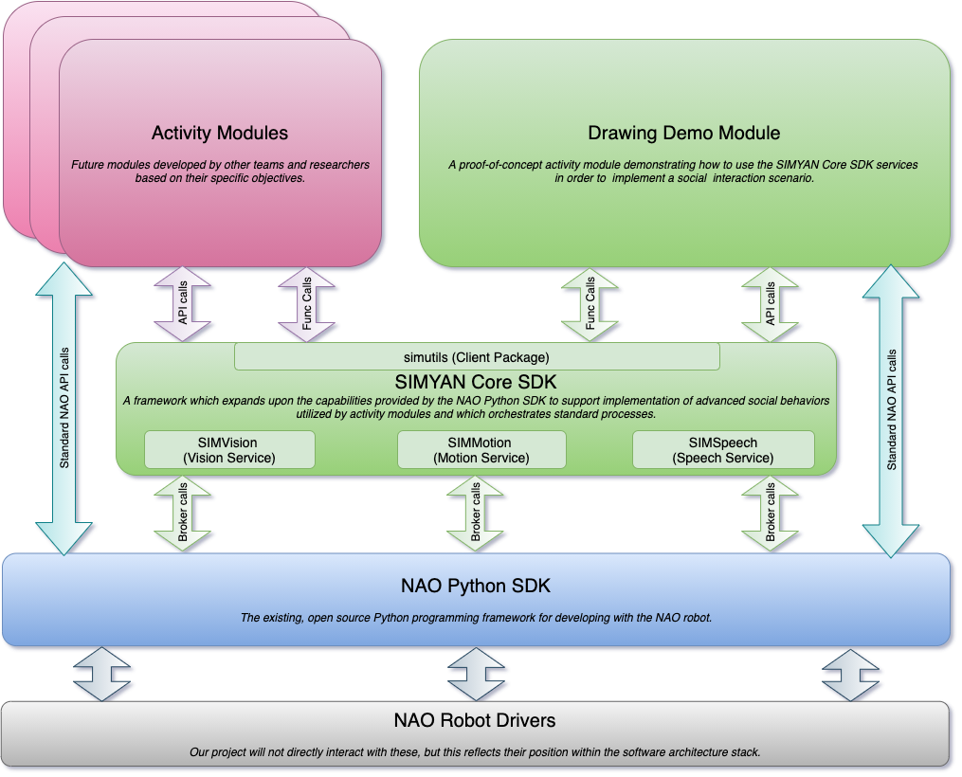
Solution Architecture
Notes:
Bryce

Slide 18
Impediments
Covid-19 pandemic caused many issues
Limited time with the robot early in the semester
NAO robot has very limited documentation
There is very little support for the NAO, so a lot of functionalities are either documented poorly or not at all.
Project turned from SDK development to R&D
Much of our time was spent figuring out how to interface with NAO instead of extending existing capabilities
Notes:
Colton
Limited documentation:
Looks extensive at first, but when diving deeper many intricacies are missing that would be overlooked initially.

Slide 19
Integration Test Strategy & Results
Test inter-module connections in the code:
Speech Recognition to Drawing Module interaction
Object Selection
Social Interaction
Motor Control Module to Drawing Module Integration
Draw on Drawing Surface
Notes:
Andrew

Slide 20
Integration Test Strategy & Results
Results:
Speech Recognition to Drawing Module interaction
Recognize verbal commands to draw a picture
Invoke speech events to draw a particular shape
Motor Control Module to Drawing Module Integration
Draw different types of shapes on the drawing surface
Circle, Triangle, Square, House (Square + Triangle)
Notes:
Andrew

Slide 21
Incomplete/Remaining Test
Incomplete Tests
Did not test for expected interaction flow from invalid picture selection
Not testable with revised speech service/events implementation
Remaining Tests
Testing Computer Vision component of checking drawing surface boundaries
Unit testing of SDK
PyTest
End-to-End Testing for error cases
Notes:
Andrew

Slide 22
PRIMARY
Development of Core SDK
Speech Recognition Support Service
Motion Support Service
Vision Support Service
Development of Drawing Activity PoC
Marker Detection & Collection
Marker Handling
Drawing Surface Detection
Drawing Specification Generator + Loader
Integrate Jetson Nano GPU with the NAO system
Support Documentation
qi/NAOqi Framework
Jetson Nano Integration
SIMYAN SDK
STRETCH
Machine Learning
Computer Vision
Natural Language Processing
Goals Overview
Notes:
Bryce

Slide 23
Development of Core SDK
SIMSpeech Service Module
Manages speech events
Allows multiple simultaneous subscribers
SIMMotion Service Module
Manages execution of motion sequences
Provides simplifying abstractions for generating motion sequences
SIMVision
Allows the robot to detect a whiteboard and its boundaries
simutils Package
Provides client-side support for utilizing SIMYAN services
Provides utilities for managing frequent NAO operations more simply and concisely
Notes:
Bryce

Slide 24
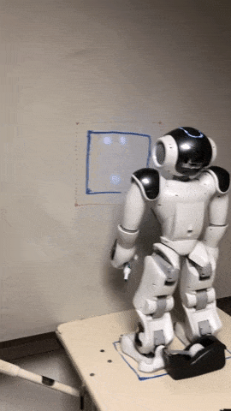
Development of Drawing Activity PoC
Marker Detection + Collection
Insufficient time to implement
Chose to focus on more generally useful capabilities
Marker Handling
Drawing demo exhibits NAO’s ability to handle a marker for drawing on a whiteboard
Drawing Surface Detection
Implemented the capability
Insufficient time to work into the drawing demo
Drawing Specification Generator + Loader
Generator mostly complete - needs tuning of Hough transform parameters to achieve morphological closing
Loader for absolute motion sequences implemented for drawing demo
Notes:
Bryce

Slide 25
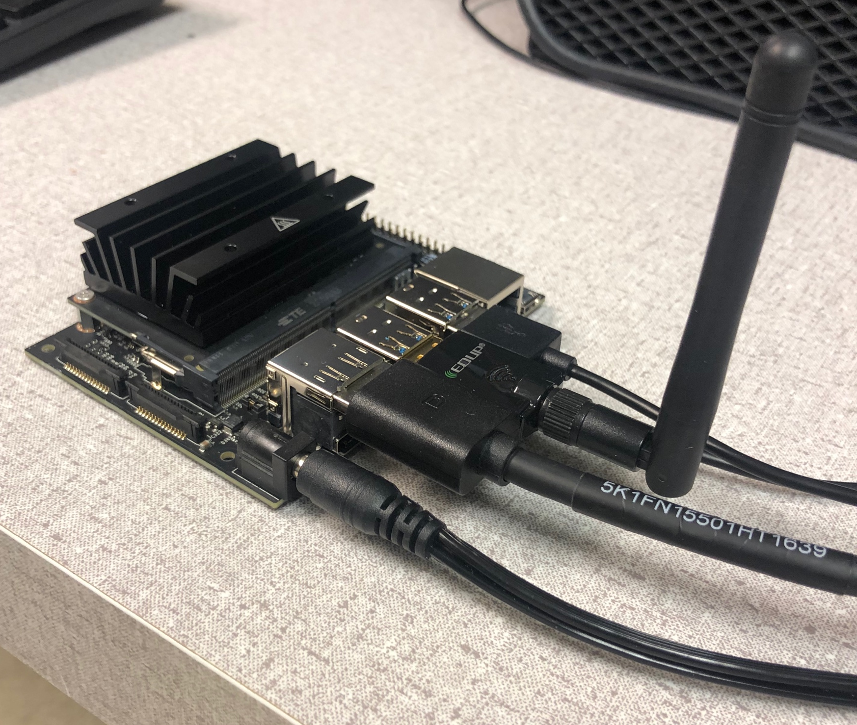
Integrate Jetson Nano with NAO
Jetson Nano setup
OS install
Wireless Access Point for NAO to connect to
Jetson Nano running qi Framework
Compiled following libraries from source
libqi
qilang
almath
All SIMYAN code can run entirely from the Nano
Takes workload away from NAO’s CPU
Can utilize Jetson Nano hardware for ML or CPU-intensive apps
Much faster development turnaround - no need to deploy to robot
Opportunity to add peripherals
XBOX Kinect
Notes:
Bryce

Slide 26
Support Documentation
Thorough in-code and auxiliary documentation for SIMYAN SDK
Valuable documentation for understanding and working with NAO
qi & NAOqi Framework(s)
NAO API Summaries
Tutorials
Python SDK Installation on Windows, Linux, Mac
Jetson Nano setup
Utilities: qibuild, qicli, robot-jumpstarter, studiotoolkit
Tips and Tricks
Code examples
Resource Links
Suggested Applications, Extensions, & Future Work
Easy-to-access GitHub Wiki
Notes:
Bryce

Slide 27
Machine Learning
Computer Vision
Had hoped to integrate XBOX Kinect and incorporate CV utilities but ran out of time
Utilizing OpenCV for Drawing Specification Generator
Natural Language Processing
Not able to implement due to impediments
Future Opportunities
Above capabilities would be fantastic opportunities to use or extend upon SIMYAN
Overhead of developing such activities significantly reduced by using SIMYAN
Jetson Nano provides excellent platform for hosting such applications
Notes:
Bryce

Slide 28
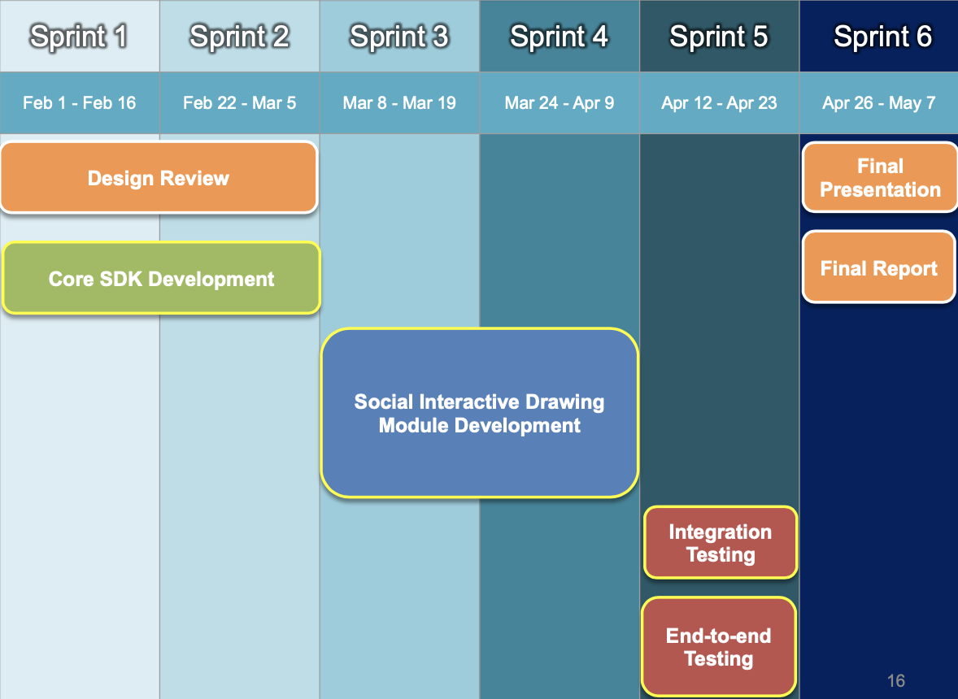
Project Schedule
Frequently fell behind sprint schedule due to unforeseen impediments
Elements of Core SDK and Activity Development pushed back multiple times
Still able to adapt, be flexible, and deliver value because of sprint approach
Notes:
Bryce

Slide 29
Lessons Learned
Frequent team meetings are key
Remote collaboration is challenging
Best when kept short and focused
Work to ensure engagement
Clarify frequently to confirm understanding
When project risk increases unexpectedly, immediately begin evaluating the schedule to compensate
Set personal and team SMART goals for every session
Notes:
Bryce
Strategic
Measurable
Attainable
Realistic
Timebound

Slide 30
Budget
Item | Quantity | Cost per Unit ($)
Jetson Nano GPU | 1 | 0 (borrowed from advisor Bill Michael)
Realtek RTL8187L Chipset 2000mW Wireless USB Wifi Adapter 54Mbps Card | 1 | 24
Xbox Kinect | 1 | 50
Power Cord | 1 | 7
Kinect Adapter | 1 | 22
Rubber Washers | 2 | 2.50
Total | 105.50
Allowance | 400
Notes:
Will

Slide 31
Conclusion
Our primary goal:
Deliver a solution that is extensible and will expand the existing vision, speech recognition, and motion capabilities of the NAO robot
Our secondary goal:
Use the SDK that we developed to enact a predefined drawing scenario
Objectives met:
We have met our original goals to create an SDK to expand original capabilities of NAO and use the SDK to enact a drawing scenario
Notes:
Colton

Slide 32
Future Opportunities
Integrate computer vision components
Edge detection can be used to detect where to draw the edges of any object
Instruction generator based on edges
Integrate feed from Xbox Kinect
Use Xbox Kinect to get a higher quality view of what the NAO can see.
Using SIMYAN SDK in future efforts
Using SIMYAN vision, speech recognition, and motion modules to perform additional tasks
Notes:
Colton

Slide 33
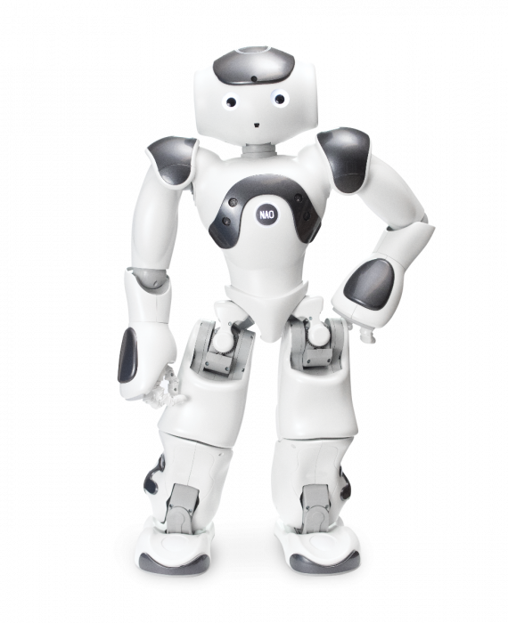
Any Questions?
Project Code and Documentation available on GitHub: https://github.com/ancient-sentinel/UCCS-Social-Robotics
https://www.eduporium.com/media/catalog/product/cache/c687aa7517cf01e65c009f6943c2b1e9/n/a/nao-print_03_4.png
Notes:
Bryce

